Slide 1
A traumatic experience . . .
Threatens the life or physical integrity of a child or of someone important to that child (parent, grandparent, sibling)
Causes an overwhelming sense of terror, helplessness, and horror
Produces intense physical effects such as pounding heart, rapid breathing, trembling, dizziness, or loss of bladder or bowel control
3

Slide 2
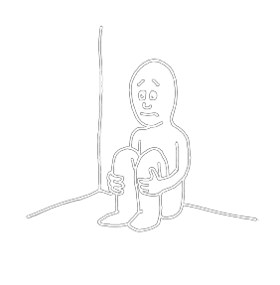
Types of Trauma: What About Neglect?
Failure to provide for a child’s basic needs
Perceived as trauma by an infant or young child completely dependent on adults for care
Opens the door to other traumatic events
May reduce a child’s ability to recover from
trauma
6

Slide 3
My Child’s Traumas
Acute
Chronic
Complex
Neglect
What don’t I know?
8

Slide 4
How Children Respond to Trauma
Long-term trauma can interfere with healthy development and affect a child’s:
Ability to trust others
Sense of personal safety
Ability to manage emotions
Ability to navigate and adjust to life’s changes
Physical and emotional responses to stress
(Continued)

Slide 5
How Children Respond to Trauma
(Continued)
A child’s reactions to trauma will vary depending on:
Age and developmental stage
Temperament
Perception of the danger faced
Trauma history (cumulative effects)
Adversities faced following the trauma
Availability of adults who can offer help, reassurance, and protection
(Continued)

Slide 6

How Children Respond to Trauma
(Continued)
Hyperarousal:
Nervousness
Jumpiness
Quickness to startle
(Continued)

Slide 7
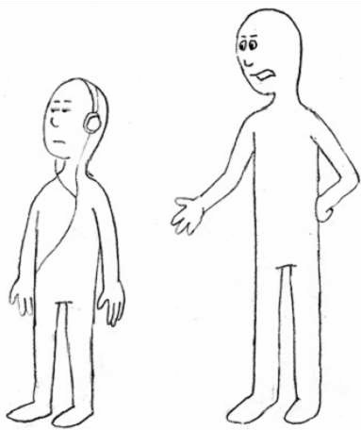
How Children Respond to Trauma
Avoidance and withdrawal:
Feeling numb, shut down, or separated from normal life
Pulling away from activities and relationships
Avoiding things that prompt memories of the trauma

Slide 8
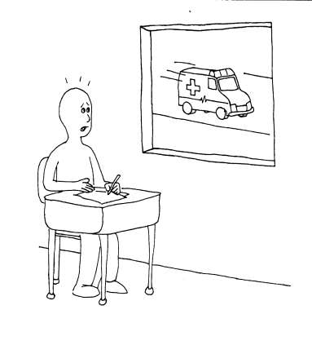
What You Might See:
Reactions to Trauma Reminders
Trauma reminders:
Things, events, situations, places, sensations, and even people that a child connects with a traumatic event
Reexperiencing
Withdrawal
Disassociation
(Continued)

Slide 9
What You Might See:
Traumatic Stress Reactions
Problems concentrating, learning, or taking in new
information
Difficulty going to sleep or staying asleep, nightmares
Emotional instability; moody, sad, or angry and
aggressive, etc.
Age-inappropriate behaviors; reacting like a much younger child

Slide 10
What You Might See:
Talking About Trauma
Talking about certain events all the time
Bringing up the topic seemingly “out of the blue”
Being confused or mistaken about details
Remembering only fragments of what happened
Avoiding talk about anything remotely related to the traumatic events

Slide 11
Recovering from Trauma: The Role of Resilience
Resilience is the ability to recover from traumatic events.
Children who are resilient see themselves as:
  Safe
  Capable
  Lovable

Slide 12
Growing Resilience
Factors that can increase resilience include:
A strong relationship with at least one competent, caring adult
Feeling connected to a positive role model/mentor
Having talents/abilities nurtured and appreciated
Feeling some control over one’s own life
Having a sense of belonging to a community, group,
or cause larger than oneself

Slide 13
Trauma Derails Development
Exposure to trauma causes the brain to develop in a way that will help the child survive in a dangerous world:
On constant alert for danger
Quick to react to threats (fight, flight, freeze)
The stress hormones produced during trauma also interfere with the development of higher brain functions.

