Slide 1
Caring for Children Who Have Experienced Trauma: A Workshop for Resource Parents.
Welcome!

Slide 2
The Basics
Who are the facilitators?
Proteus Foster Family & Abrazo Foster Family
Gurpreet Bar & Dr. John Lott
Where are the bathrooms?
Out the East Door or the South Door and in the hallway

Slide 3
Why a Trauma Workshop?
Many children in foster care have lived through traumatic experiences.
Children bring their traumas with them into our homes.
Trauma affects a child’s behavior, feelings, relationships, and view of the world in profound ways.

Slide 4


Feelings Thermometer
Very Hot
Very uncomfortable Extremely stressed and anxious
Need to get out of here now
Warm
Mildly uncomfortable Slightly stressed and anxious
Losing my focus
Cool
A little bored Losing my focus
Hot Moderately uncomfortable
Stressed and anxious
Distracted and edgy
Just right
Comfortable
Not stressed or anxious
Ice Cold
Totally bored
Not focused or engaged Planning my escape

Slide 5
The Challenge
Caring for children who have been through trauma can leave resource parents feeling:
Confused
Frustrated
Unappreciated
Angry
Helpless

Slide 6
The Solution: Trauma-Informed Parenting
When you understand what trauma is and how it has affected your child, it becomes easier to:
Communicate with your child
Improve your child’s behavior and attitudes
Get your child the help he or she needs
Reduce the risk of your own compassion fatigue or secondary traumatization
Become a more effective and satisfied resource parent
21

Slide 7
The Essential Elements of
Trauma-Informed Parenting
Recognize the impact trauma has had on your child.
Help your child to feel safe.
Help your child to understand and manage overwhelming emotions.
Help your child to understand and modify problem behaviors.
Respect and support positive, stable, and enduring relationships in the life of your child.
Help your child to develop a strength-based understanding of his or her life story.
Be an advocate for your child.
Promote and support trauma-focused assessment and treatment for your child.
Take care of yourself.

Slide 8
Myths to Avoid
My love should be enough to erase the effects of everything bad that happened before.
My child should be grateful and love me as much as I love him/her.
My child shouldn’t love or feel loyal to an abusive parent.
It’s better to just move on, forget, and not talk about past painful experiences.

Slide 9
A traumatic experience . . .
Threatens the life or physical integrity of a child or of someone important to that child (parent, grandparent, sibling)
Causes an overwhelming sense of terror, helplessness, and horror
Produces intense physical effects such as pounding heart, rapid breathing, trembling, dizziness, or loss of bladder or bowel control
3

Slide 10
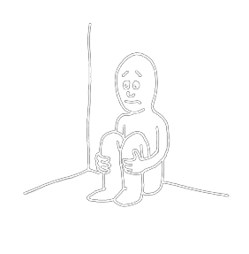
Types of Trauma: What About Neglect?
Failure to provide for a child’s basic needs
Perceived as trauma by an infant or young child completely dependent on adults for care
Opens the door to other traumatic events
May reduce a child’s ability to recover from
trauma
6

Slide 11
My Child’s Traumas
Acute
Chronic
Complex
Neglect
What don’t I know?
8

Slide 12
How Children Respond to Trauma
Long-term trauma can interfere with healthy development and affect a child’s:
Ability to trust others
Sense of personal safety
Ability to manage emotions
Ability to navigate and adjust to life’s changes
Physical and emotional responses to stress
(Continued)

Slide 13
How Children Respond to Trauma
(Continued)
A child’s reactions to trauma will vary depending on:
Age and developmental stage
Temperament
Perception of the danger faced
Trauma history (cumulative effects)
Adversities faced following the trauma
Availability of adults who can offer help, reassurance, and protection
(Continued)

Slide 14

How Children Respond to Trauma
(Continued)
Hyperarousal:
Nervousness
Jumpiness
Quickness to startle
(Continued)

Slide 15
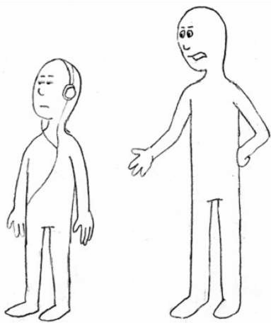
How Children Respond to Trauma
Avoidance and withdrawal:
Feeling numb, shut down, or separated from normal life
Pulling away from activities and relationships
Avoiding things that prompt memories of the trauma

Slide 16
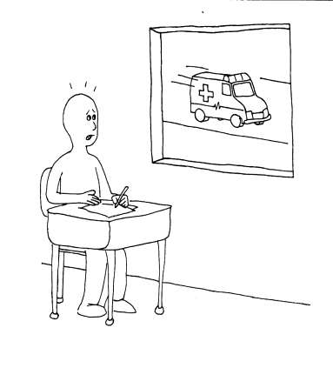
What You Might See:
Reactions to Trauma Reminders
Trauma reminders:
Things, events, situations, places, sensations, and even people that a child connects with a traumatic event
Reexperiencing
Withdrawal
Disassociation
(Continued)

Slide 17
What You Might See:
Traumatic Stress Reactions
Problems concentrating, learning, or taking in new
information
Difficulty going to sleep or staying asleep, nightmares
Emotional instability; moody, sad, or angry and
aggressive, etc.
Age-inappropriate behaviors; reacting like a much younger child

Slide 18
What You Might See:
Talking About Trauma
Talking about certain events all the time
Bringing up the topic seemingly “out of the blue”
Being confused or mistaken about details
Remembering only fragments of what happened
Avoiding talk about anything remotely related to the traumatic events

Slide 19
Recovering from Trauma: The Role of Resilience
Resilience is the ability to recover from traumatic events.
Children who are resilient see themselves as:
  Safe
  Capable
  Lovable

Slide 20
Growing Resilience
Factors that can increase resilience include:
A strong relationship with at least one competent, caring adult
Feeling connected to a positive role model/mentor
Having talents/abilities nurtured and appreciated
Feeling some control over one’s own life
Having a sense of belonging to a community, group,
or cause larger than oneself

Slide 21
Trauma Derails Development
Exposure to trauma causes the brain to develop in a way that will help the child survive in a dangerous world:
On constant alert for danger
Quick to react to threats (fight, flight, freeze)
The stress hormones produced during trauma also interfere with the development of higher brain functions.

Slide 22
Young Children (0–5)
Key Developmental Tasks | Trauma’s Impact
Development of visual and auditory perception Recognition of and response to emotional cues Attachment to primary caregiver | Sensitivity to noise Avoidance of contact Heightened startle response Confusion about what’s dangerous and who to go to for protection Fear of being separated from familiar people/places
(Continued)

Slide 23
School-Aged Children (6–12)
Key Developmental Tasks | Trauma’s Impact
Manage fears, anxieties, and aggression Sustain attention for learning and problem solving Control impulses and manage physical responses to danger | Emotional swings Learning problems Specific anxieties and fears Attention seeking Reversion to younger behaviors
(Continued)

Slide 24
Adolescents (13–21)
Key Developmental Tasks | Trauma’s Impact
Think abstractly Anticipate and consider the consequences of behavior Accurately judge danger and safety Modify and control behavior to meet long term goals | Difficulty imagining or planning for the future Over- or underestimating danger Inappropriate aggression Reckless and/or self-destructive behaviors

Slide 25
What Trauma-Informed Parents Can Do
Offer a secure base of love and protection.
Be emotionally and physically available.
Recognize and respond to the child’s needs.
Provide guidance and example.
Provide opportunities to safely explore the world.

Slide 26
Safety and Trauma
Physical safety is not the same as psychological safety.
Your child’s definition of “safety” will not be the same as yours.
To help your child feel safe, you will need to look at the world through his or her “trauma lens.”
(Continued)

Slide 27
Safety and Trauma (Continued)
Children who have been through trauma may:
Have valid fears about their own safety or the safety of loved ones
Have difficulty trusting adults to protect them
Be hyperaware of potential threats
Have problems controlling their reactions to perceived threats

Slide 28
Promoting Safety
Help children get familiar with the house and neighborhood.
Give them control over some aspects of their lives.
Set limits.
Let them know what will happen next.
See and appreciate them for who they are.
Help them to maintain a sense of connection and continuity with the past.

Slide 29
Give a Safety Message
Partner with the social worker or caseworker.
Get down to the child’s eye level.
Promise to keep the child physically safe.
Ask directly what the child needs to feel safe.
Follow the child’s lead.
Let the child know that you are ready to hear what he or she needs.
(Continued)

Slide 30
Give a Safety Message (Continued)
Take concerns seriously:
Empathize.
Acknowledge that the child’s feelings make sense in light of past experiences.
Be reassuring and realistic about what you can do.
Be honest about what you do and don’t know.
Help your child to express his or her concerns to other members of the child welfare team.

Slide 31
Manage Emotional “Hot Spots”
Food and mealtime
Sleep and bedtime
Physical boundaries, privacy, personal grooming, medical care

Slide 32
Identifying Trauma Reminders
When your child or adolescent has a reaction, make note of:
  When
  Where
  What
When possible, reduce exposure.
Share your observations with your child’s caseworker and therapist.

Slide 33
Coping with Trauma Reminders: What NOT to Do
Assume the child is being rebellious
Tell the child he or she is being dramatic or “overreacting”
Force the child to face reminder
Express anger or impatience

Slide 34
Coping with Trauma Reminders: What Children Can Do—SOS
Stop
  Stop and take several long, deep breaths.
Orient
  Look around and take in immediate surroundings.
  Make note of physical reactions (breathing, heartbeat, etc).
Seek Help
  Use a “stress buster” to help calm down.
  If needed, call a trusted friend or reliable adult.

Slide 35
SOS: Identifying Stress Busters
Activities (running, playing a particular song)
Things (a toy, a stuffed animal, a picture, a favorite blanket, a particular food)
Places (a spot in the yard or a park, a room)
People
A specific thought, phrase, or prayer

Slide 36
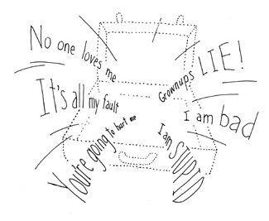
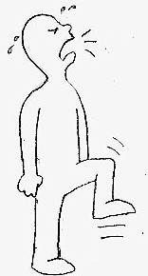

The Cognitive Triangle
Thoughts
Behaviors
Feelings

Slide 37
Trauma and the Triangle
Children who have experienced trauma may find it hard to:
See the connection between their feelings, thoughts, and behaviors
Understand and express their own emotional reactions
Accurately read other people’s emotional cues
Control their reactions to threats or trauma reminders

Slide 38
Trauma and the Triangle
(Continued)
Children may act out as a way of:
Reenacting patterns or relationships from the past
Increasing interaction, even if the interactions are negative
Keeping caregivers at a physical or emotional distance
“Proving” the beliefs in their Invisible Suitcase
Venting frustration, anger, or anxiety
Protecting themselves

Slide 39
Decoding the Triangle
Thoughts?
Behaviors?
Feelings?
(Continued)

Slide 40
How You Can Help
Differentiate yourself from past caregivers.
Tune in to your child’s emotions.
Set an example of the emotional expression and behaviors you expect.
Encourage positive emotional expression and behaviors by supporting the child’s strengths and interests.
Correct negative behaviors and inappropriate or destructive emotional expression, and help your child build new behaviors and emotional skills.

Slide 41
Children Define Themselves
Through Their Connections
Who am I?
What is lovable about me?
What am I capable of?
How can I survive and make sense out of what’s happened to me?
Who will I be in the future?

Slide 42
Making It Safe to Talk
Makes the “unmentionable” mentionable
Reinforces the message that the child is not responsible for the trauma
Provides an opportunity to correct mistaken
beliefs
Teaches children that trauma does not have to define their lives

Slide 43
Talking About Trauma
Expect the unexpected.
Be aware of your reactions.
Don’t make assumptions.
Be ready to listen and talk openly with your child, rather than avoiding the topic.

Slide 44
Talking About Trauma (Continued)
Stop what you are doing and make eye contact.
Listen quietly.
Provide simple, encouraging remarks in a calm tone of voice.
Avoid “shutting down” the child.

Slide 45
Building New Connections
Build connections across the disruptions in your child’s life:
Document positive events and experiences
(photos, scrapbooks, journals, etc.).
Help “reconstruct” past experiences.
Encourage your child to look forward to future goals and dreams.

Slide 46
Know Your Child’s Team
Legal team
Caseworker
Resource parents
Educators
Therapist
Child
Medical team
Birth parents
Other birth family members
Strong, positive connection
Weak connection
Stressful connection

Slide 47
Working as a Team
The team members involved in your child’s life:
Share a commitment to your child’s safety, permanency, and well-being
Have distinct roles and responsibilities
Relate to your child in different ways
Are NOT equally trauma-informed

Slide 48
Working as a Team
The team members involved in your child’s life:
Share a commitment to your child’s safety, permanency, and well-being
Have distinct roles and responsibilities
Relate to your child in different ways
Are NOT equally trauma-informed

Slide 49
Trauma-Informed Advocacy
(Continued)
Support the positive, stable, and enduring relationships in the life of your child.
Help others to appreciate your child’s strengths and resilience.
Advocate for the trauma-specific services your child needs.
Know when you need support.

Slide 50
Partnering with Birth Families
Respect the connection that children share with their parents and other birth family members.
Be prepared for conflicted or even hostile initial reactions from birth parents and other family members.
Use your “trauma lens” when interacting with birth parents and other family members.

Slide 51
When to Seek Help
When you:
Feel overwhelmed
When your child:
Displays reactions that interfere with school or home life
Talks about or commits acts of self-harm (like cutting)
Has trouble falling asleep, wakes up often during the night, or frequently has nightmares
Complains of frequent physical problems but checks out okay medically
(Continued)

Slide 52
When to Seek Help
(Continued)
When your child:
Asks to talk to someone about his or her trauma
Talks over and over again about the trauma or seems “stuck” on one aspect of it
Seems plagued by guilt or self-blame
Expresses feelings of helplessness and hopelessness

